Slide 1

ELECTRONIC DEVICES AND CIRCUITS
Prepared By:
Mr. G.BABU Assoc. Prof.
ECE Dept. VCE

Slide 2
UNIT – I
P-N Junction Diode: Qualitative Theory of P-N Junction, P-N Junction as a Diode, Diode Equation, Volt-Ampere Characteristics, Temperature dependence of VI characteristic, Ideal versus Practical – Resistance levels (Static and Dynamic), define Transition and Diffusion Capacitances, varactor diode, photo diode, Breakdown Mechanisms in Semiconductor Diodes, Zener Diode Characteristics.

Slide 3


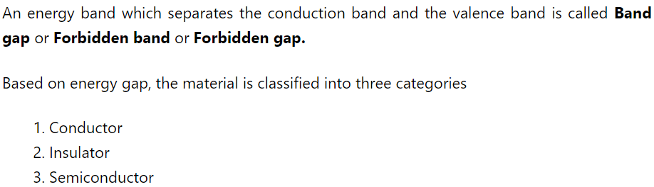

Slide 4
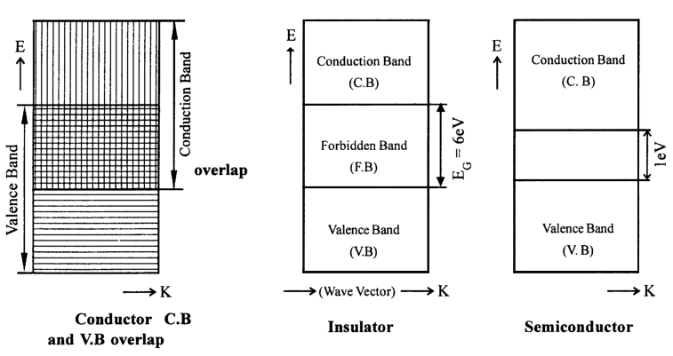

Slide 5
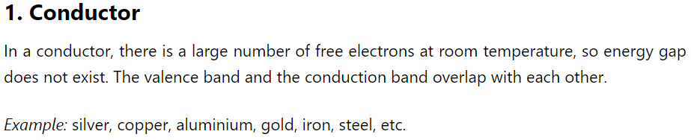
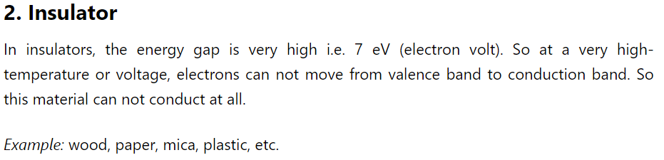

Slide 6

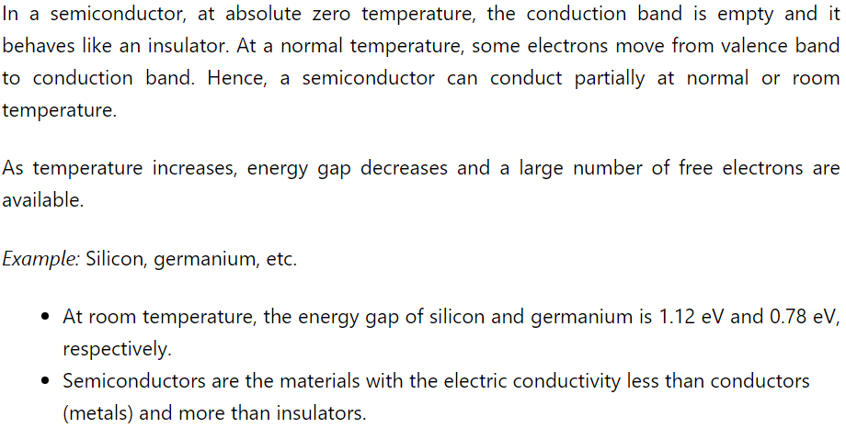

Slide 7
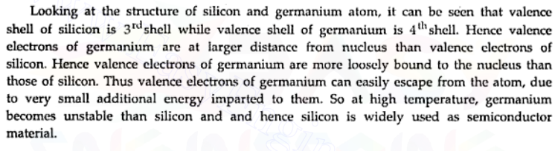
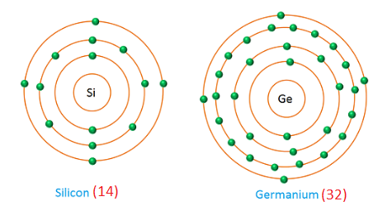
Why silicon is widely used than germanium?
Atomic structure of silicon and germanium

Slide 8
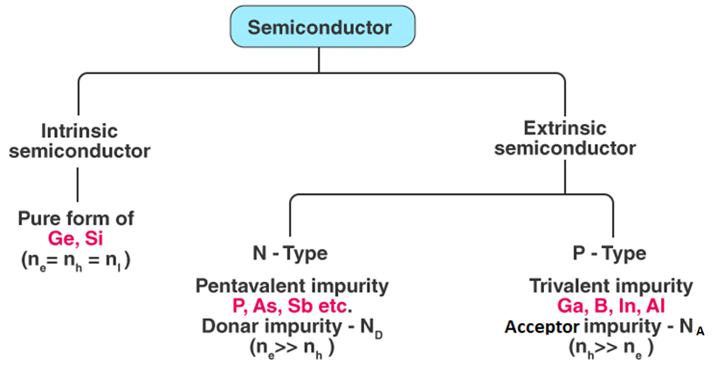
Types of Semiconductors

Slide 9
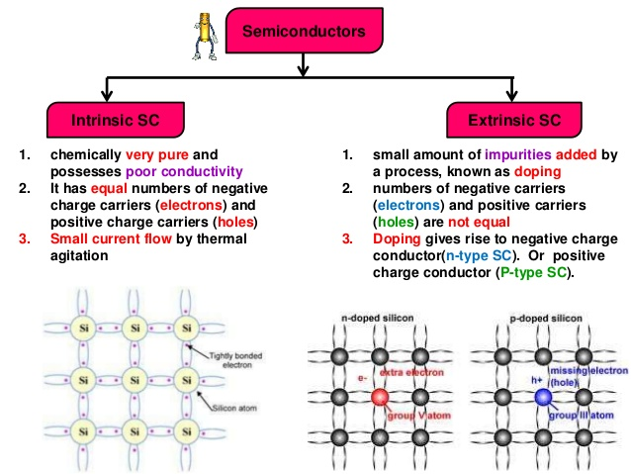

Slide 10
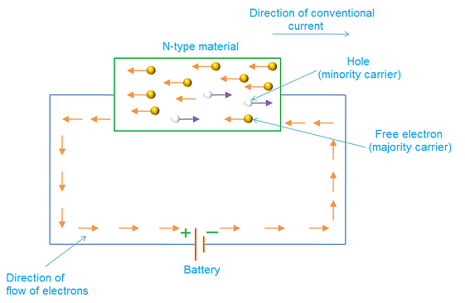
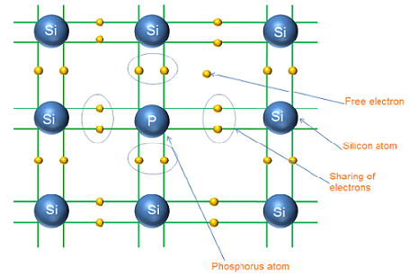
N-type semiconductor
Conduction in n-type semiconductor

Slide 11
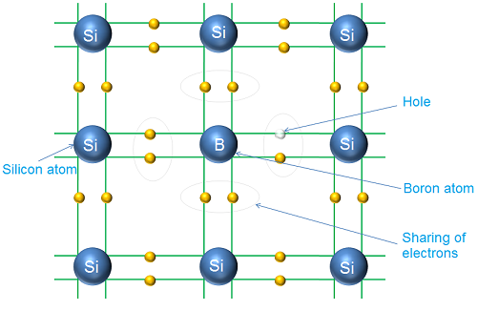
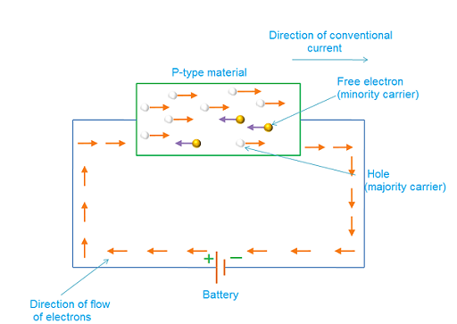
P-type semiconductor
Conduction in p-type semiconductor

Slide 12
Majority & minority charge carriers
What is charge carrier?
Particles such as free electrons and holes carry the charge or electric current from one place to another place.
Negative charge carriers
The negative charge carriers such as free electrons are the charge carriers that carry negative charge with them while moving from one place to another place. Free electrons are the electrons that are detached from the parent atom and moves freely from one place to another place.
Positive charge carriers
The positive charge carriers such as holes are the charge carriers that carry positive charge with them while moving from one place to another place. Holes are the vacancies in valence band that moves from one place to another place within the valence band.
Majority and minority charge carriers definition
The charge carriers that are present in large quantity are called majority charge carriers. The majority charge carriers carry most of the electric charge or electric current in the semiconductor.
The charge carriers that are present in small quantity are called minority charge carriers. The minority charge carriers carry very small amount of electric charge or electric current in the semiconductor.

Slide 13
Charge carriers in intrinsic semiconductor
The semiconductors that are in pure form are called intrinsic semiconductors.
Total negative charge carriers = Total positive charge carriers
Majority and minority charge carriers in n-type semiconductor
Total negative charge carriers > Total positive charge carriers
Majority and minority charge carriers in p-type semiconductor
Total negative charge carriers < Total positive charge carriers

Slide 14
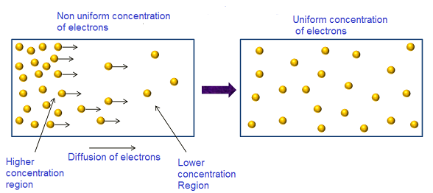
Diffusion current
The process by which, charge carriers (electrons or holes) in a semiconductor moves from a region of higher concentration to a region of lower concentration is called diffusion.

Slide 15
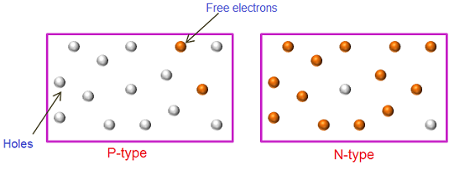
Formation of P-N Junction
Generally, junction refers to a point where two or more things are joined.
In n-type semiconductors electrons are the majority carriers while holes are the minority carriers. On the other hand, in p-type semiconductors holes are the majority carriers while electrons are the minority carriers.
The p-type and n-type semiconductors are not used separately for practical purpose because the overall charge of p-type and n-type semiconductors is electrically neutral.

Slide 16
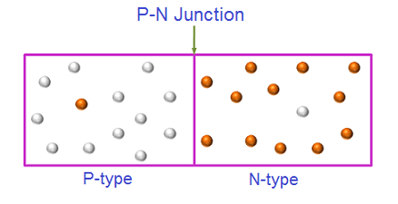
When an n-type semiconductor is joined with the p-type semiconductor, a p-n junction is formed.
The p-type and n-type are chemically combined with a special fabrication technique to form the pn-junction.
The region where the p-type and n-type semiconductors are joined is called p-n junction.
This p-n junction forms a most popular semiconductor device known as diode.
P-n junction is also a fundamental building block of many other semiconductor electronic devices such as transistors, solar cells, light emitting diodes, and integrated circuits.
The credit of discovery of the p-n junction goes to American physicist Russel Ohi of Bell Laboratories.
Semiconductor devices are the fundamental building blocks of all the electronic devices such as computers, control systems, ATM (Automated Teller Machine), mobile phones, amplifiers, etc.

Slide 17
Before the invention of semiconductor diode there was vacuum tubes which are larger in size, takes more power, costly, and noisy.
This problem was solved with invention of semiconductor diode. Semiconductor diodes are smaller in size, low cost and consume less power.

Slide 18
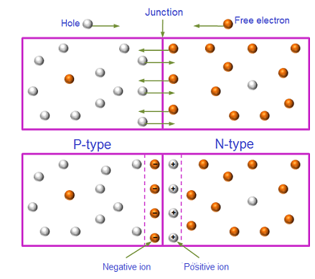
Zero bias / Unbiased P-N junction
The p-n Junction in which no external voltage is applied is called zero bias p-n junction.
Zero bias pn- Junction is also called as unbiased p-n junction.
Charge carriers crossing the junction
Formation of positive and negative ion

Slide 19
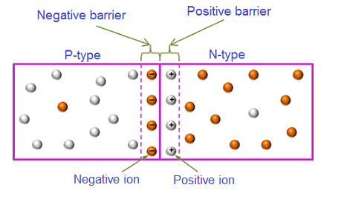
Barrier voltage
A barrier is build near the junction which prevents the further movement of electrons and holes.
The negative charge formed at the p-side of the p-n junction is called negative barrier voltage while the positive charge formed at the n-side of the p-n junction is called positive barrier voltage. The total charge formed at the p-n junction is called barrier voltage, barrier potential or junction barrier.
The size of the barrier voltage at the p-n junction is depends on, the amount of doping, junction temperature and type of material used. The barrier voltage for silicon diode is 0.7 volts and for germanium is 0.3 volts.

Slide 20
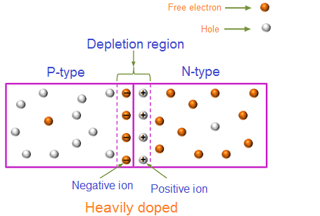
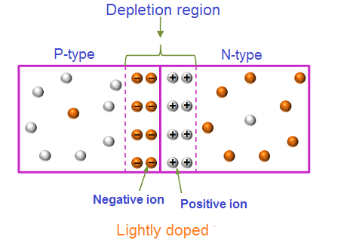
Width of depletion region
The physical width of the depletion region in a typical Si diode ranges from a fraction of a micrometer to tens of micrometers
1 micron =

Slide 21
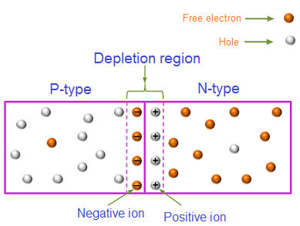
Depletion region
What is depletion region?
Generally, depletion refers to reduction or decrease in quantity of something.
The depletion region refers to a region where flow of charge carriers are decreased over a given time and finally results in empty mobile charge carriers or full of immobile charge carriers.

Slide 22
The net negative charge at p-side of the p-n junction prevents further flow of free electrons crossing from n-side to p-side because the negative charge present at the p-side of the p-n junction repels the free electrons.
Similarly, the net positive charge at n-side of the p-n junction prevents further flow of holes from p-side to n-side.
Thus, immobile positive charge at n-side and immobile negative charge at p-side near the junction acts like a barrier or wall and prevent the further flow of free electrons and holes. The region near the junction where flow of charges carriers are decreased over a given time and finally results in empty charge carriers or full of immobile charge carriers is called depletion region.
The depletion region is also called as depletion zone, depletion layer, space charge region, or space charge layer. The depletion region acts like a wall between p-type and n-type semiconductor and prevents further flow of free electrons and holes.

Slide 23
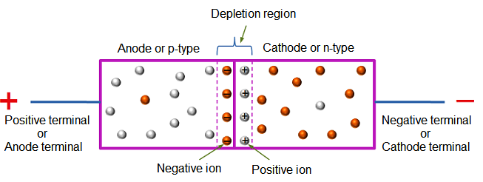

P-N junction diode
A p-n junction diode is two-terminal or two-electrode semiconductor device, which allows the electric current in only one direction while blocks the electric current in opposite or reverse direction.
The basic symbol of p-n junction diode structure of p-n junction diode

Slide 24
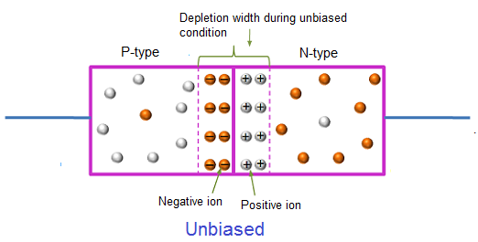
There are three biasing conditions for p-n junction diode and this is based on the voltage applied:
Zero bias / Unbiased : There is no external voltage applied to the p-n junction diode.
Forward bias: The positive terminal of the voltage potential is connected to the p-type while the negative terminal is connected to the n-type.
Reverse bias: The negative terminal of the voltage potential is connected to the p-type and the positive is connected to the n-type

Slide 25
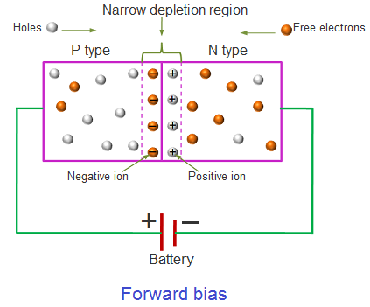
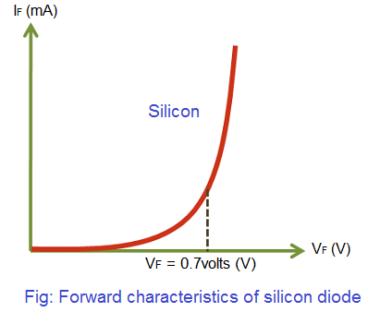
Forward biased p-n junction diode
In forward biased p-n junction diode, the positive terminal of the battery is connected to the p-type semiconductor material and the negative terminal of the battery is connected to the n-type semiconductor material.
The voltage at which the diode starts to conduct significantly is called the knee voltage or cut-in voltage and is equal to the barrier potential of the p-n junction.
For Si=0.7v and Ge=0.3v.

Slide 26
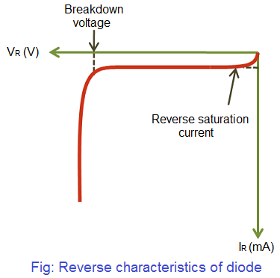
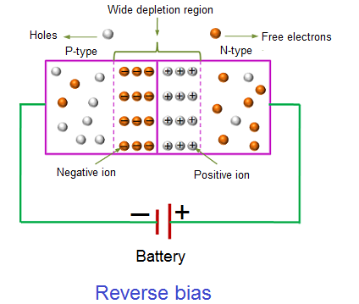
Reverse biased p-n junction diode
In reverse biased p-n junction diode, the positive terminal of the battery is connected to the n-type semiconductor material and the negative terminal of the battery is connected to the p-type semiconductor material.
holes from the p-side are attracted towards the negative terminal whereas free electrons from the n-side are attracted towards the positive terminal.

Slide 27
BREAK DOWN MECHANISMS
The critical value of the voltage, at which the breakdown of a P-N junction diode occurs, is called the breakdown voltage.
There are two mechanisms by which breakdown can occur at a reverse biased P-N junction:
Avalanche breakdown
Zener breakdown
Avalanche breakdown
The minority carriers, under reverse biased conditions, flowing through the junction acquire a kinetic energy which increases with the increase in reverse voltage. At a sufficiently high reverse voltage (say 5 V or more), the kinetic energy of minority carriers becomes so large that they knock out electrons from the covalent bonds of the semiconductor material. As a result of collision, the liberated electrons in turn liberate more electrons and the current becomes very large leading to the breakdown of the crystal structure itself. This phenomenon is called the avalanche breakdown.
Zener breakdown
When a pn-junction is heavily doped the depletion region is very narrow. So under reverse bias the electric field across the depletion region is very intense. Such an intense field is enough to pull the valency electrons from the stable atoms. Such a creation of free electrons is called Zener effect.

Slide 28
DIFFERENCE BETWEEN ZENER
AND AVALANCHE BREAKDOWN
Zener Breakdown
1.This occurs at junctions which being
heavily doped have narrow depletion
layers
2. This breakdown voltage sets a
very strong electric field across
this narrow layer.
3. Here electric field is very strong
to rupture the covalent bonds
thereby generating electron-hole
pairs. So even a small increase in
reverse voltage is capable of producing
Large number of current carriers.
4. Zener diode exhibits negative temp:
coefficient. Ie. breakdown voltage
decreases as temperature increases.
Avalanche breakdown
1. This occurs at junctions which
being lightly doped have wide depletion layers.
2. Here electric field is not strong
enough to produce Zener breakdown.
3. Her minority carriers collide with semi
conductor atoms in the depletion region, which
breaks the covalent bonds and electron-hole
pairs are generated. Newly generated charge
carriers are accelerated by the electric field
which results in more collision and generates
avalanche of charge carriers. This results in
avalanche breakdown.
4. Avalanche diodes exhibits positive temp:
coefficient. i.e breakdown voltage increases
with increase in temperature.

Slide 29
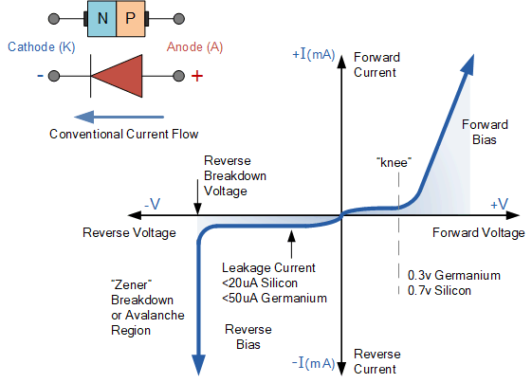
V-I characteristics of p-n junction diode
The point at which this sudden increase in current takes place is represented on the static I-V characteristics curve above as the "knee" point.
Under RB a very small leakage current does flow through the junction which can be measured in microamperes, (μA).
If reverse bias voltage Vr applied to the diode is increased to a sufficiently high enough value, it will cause the PN junction to overheat and fail due to the avalanche effect around the junction. This may cause the diode to become shorted and will result in the flow of maximum circuit current,

Slide 30
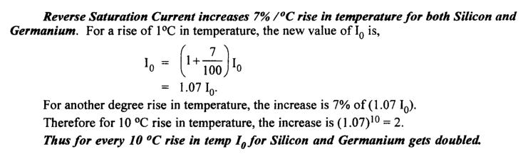
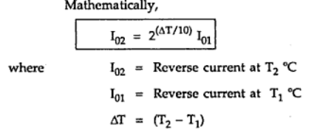
TEMPERATURE DEPENDANCE OF P-N JUNCTION DIODE CHARACTERISTICS

Slide 31
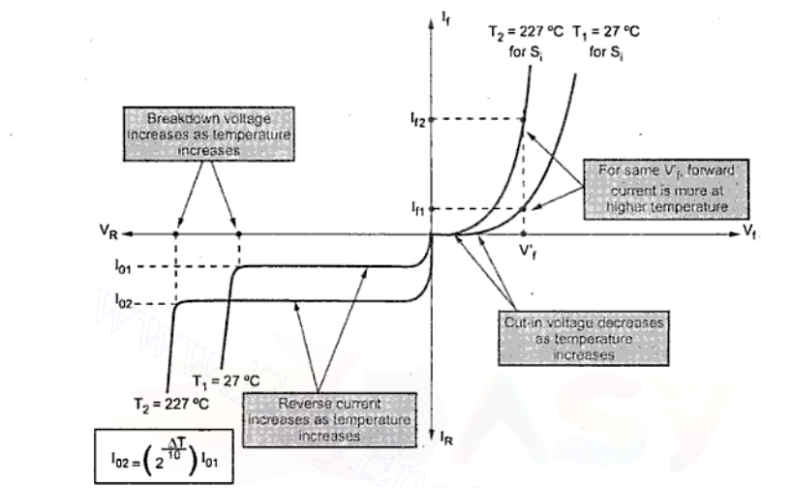

Slide 32
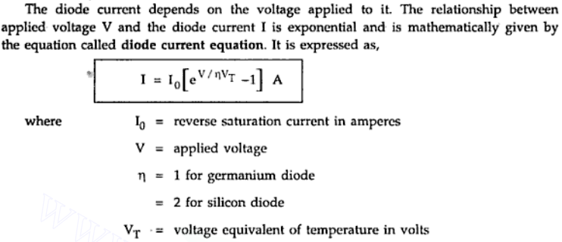
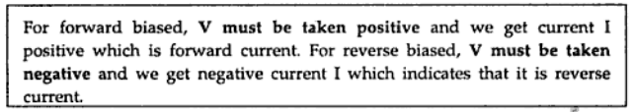
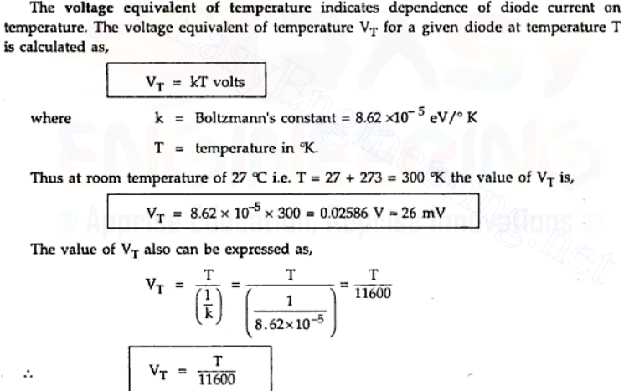
Diode current Equation

Slide 33
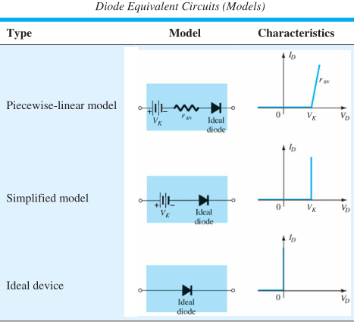
Junction Diode Ideal and Real Characteristics
The ideal diode or perfect diode is a two terminal device, which completely allows the electric current without any loss under forward bias and completely blocks the electric current with infinite loss under reverse bias.
Ideal diodes actually do not exist.
The real diode or practical diode is a two terminal device, which allow most of the electric current under forward bias, and block most of the electric current under reverse bias.

Slide 34
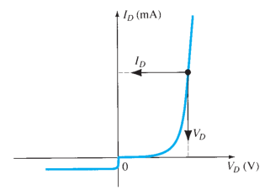

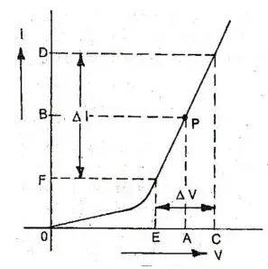



Diode Resistance
A p-n junction diode allows electric current in one direction and blocks electric current in another direction
The depletion region present in a diode acts like barrier to electric current. Hence, it offers resistance to the electric current.
The two types of resistance takes place in the p-n junction diode are:
Forward resistance : Resistance offered by the p-n junction diode when it is forward biased.
Reverse resistance : Resistance offered by the p-n junction diode when it is reverse biased.
The forward resistance can be further grouped into two category.
Static resistance or DC resistance
Dynamic resistance or AC resistance

Slide 35
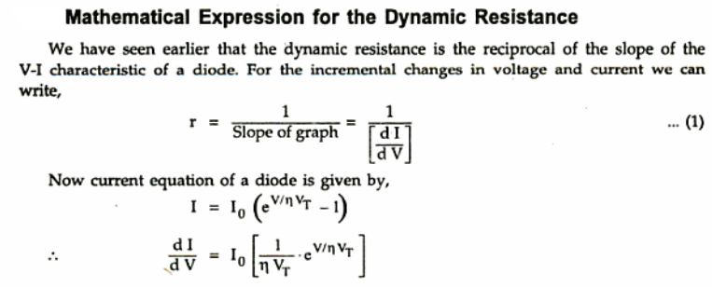
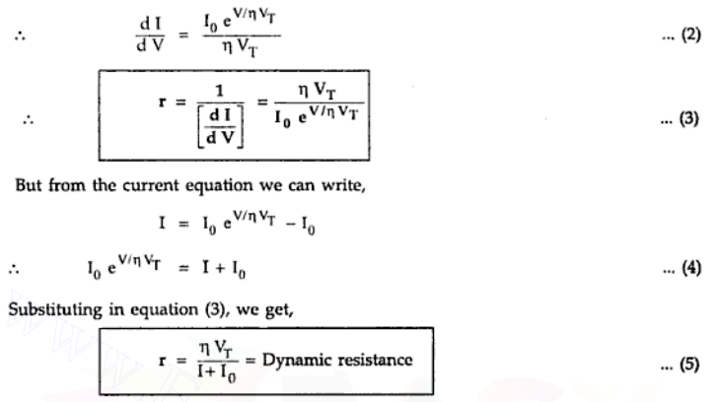

Slide 36
Diode junction capacitance
In a p-n junction diode, two types of capacitance take place. They are,
Transition capacitance (C_{T})
Diffusion capacitance (C_{D})
Transition capacitance (C_{T}) : In a reverse biased diode, the transition capacitance exist.
Under reverse bias, charged particles are moved away from the junction i.e., the depletion layer width increases. Hence there exists a change in charge (dQ) with respect to change in applied reverse voltage (dV). Nothing but capacitance effect. Such capacitance under reverse bias condition is called as Transition capacitance, barrier capacitance, space charge capacitance or depletion layer capacitance.
CT = dQ / dV
Where, CT = Transition capacitance
dQ = Change in electric charge
dV = Change in voltage
The transition capacitance can be mathematically written as,
C_{T} = ε A / W
Where,
ε = Permittivity of the semiconductor
A = Area of plates or p-type and n-type regions
W = Width of depletion region

Slide 37
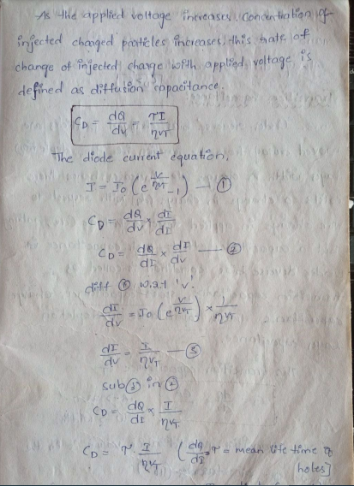
Diffusion capacitance (C_{D})
Diffusion capacitance occurs in a forward biased p-n junction diode. Diffusion capacitance is also sometimes referred as storage capacitance.
The diffusion capacitance value will be in the range of nano farads (nF) to micro farads (μF).

Slide 38
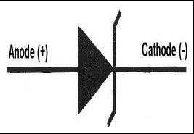
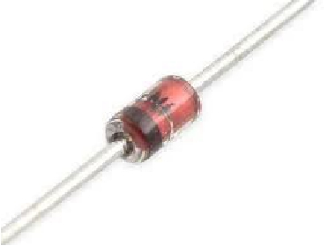
Zener Diode
Introduction
The zener diode is a silicon pn junction devices that differs from rectifier
diodes because it is designed for operation in the reverse-breakdown
region. The breakdown voltage of a zener diode is set by carefully
controlling the level during manufacture. The basic function of zener
diode is to maintain a specific voltage across it’s terminals within given
limits of line or load change. Typically, it is used for providing a stable
reference voltage for use in power supplies and other equipment.

Slide 39
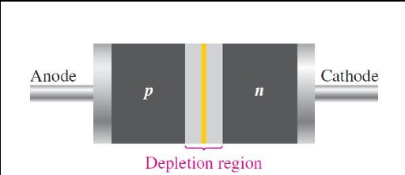
Construction of Zener
Zener diodes are designed to operate in reverse breakdown. Two types of reverse
breakdown in a zener diode are avalanche and zener. The avalanche break down
occurs in both rectifier and zener diodes at a sufficiently high reverse voltage. Zener
breakdown occurs in a zener diode at low reverse voltages.
A zener diode is heavily doped to reduce the breakdown voltage.
This causes a very thin depletion region.
The zener diodes breakdown characteristics are determined by the
doping process
Zeners are commercially available with voltage breakdowns of 1.8 V
to 200 V.

Slide 40
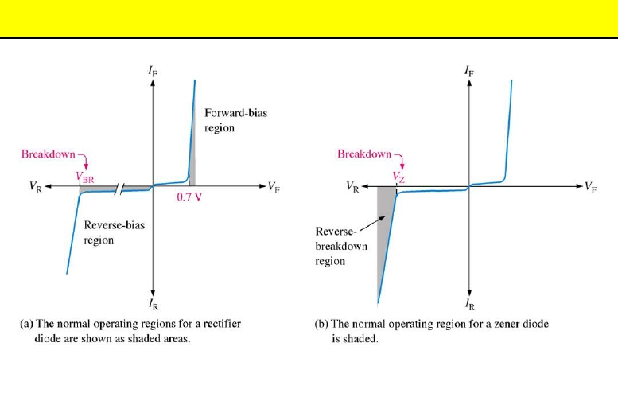
Working of Zener
A zener diode is much like a normal diode. Zener diode is heavily doped than the normal p-n junction diode. It operates in reverse breakdown.
This typical characteristic curve illustrates the operating range for a zener.
Note that its forward characteristics are just like a normal diode.

Slide 41
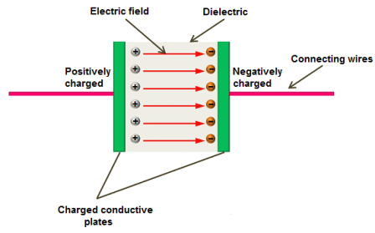
What is a capacitor?
A capacitor is an electronic component that stores electrical energy or electric charge in the form of an electric field.The basic capacitor is made up of two parallel conductive plates separated by a dielectric. The two conductive plates acts like electrodes and the dielectric acts like an insulator.

Slide 42
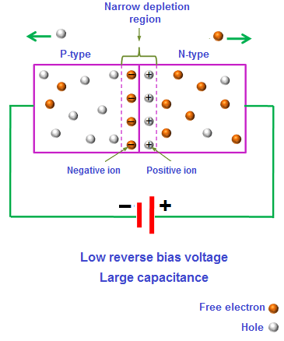
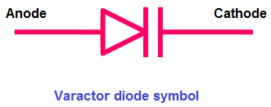
What is varactor diode?
The term varactor is originated from a variable capacitor. Varactor diode operates only in reverse bias. The varactor diode acts like a variable capacitor under reverse bias.
Varactor diode is also sometimes referred to as varicap diode, tuning diode, variable reactance diode, or variable capacitance diode.
Two parallel lines at the cathode side represents two conductive plates and the space between these two parallel lines represents dielectric.
An insulator or a dielectric does not allow electric current through it. The depletion region also does not allow electric current through it. So the depletion region acts like a dielectric of a capacitor.

Slide 43
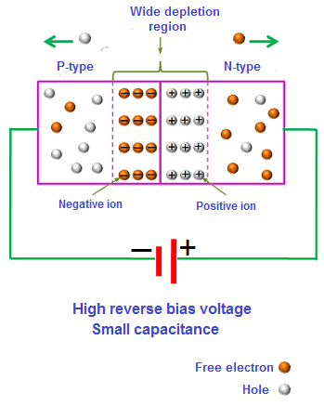
How varactor diode works?
When a reverse bias voltage is applied, the width of depletion region increases and the capacitance decreases.
If the applied reverse bias voltage is very low the capacitance will be very large.
The capacitance is inversely proportional to the width of the depletion region and directly proportional to the surface area of the p-region and n-region. So, the capacitance decreases as the as the width of depletion region increases.
If the reverse bias voltage is increased, the width of depletion region further increases, and the capacitance further decreases.
On the other hand, if the reverse bias voltage is reduced, the width of depletion region decreases, and the capacitance increases.

Slide 44
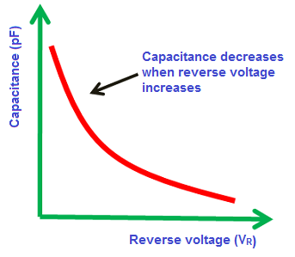
Characteristics of varactor diode
In a varactor diode, the capacitance is varied when the voltage is varied. So the varactor diode is a variable capacitor. The capacitance of a varactor diode is measured in picofarads (pF).
Applications of varactor diode
Varactor diode is used in frequency multipliers.
Varactor diode is used in parametric amplifiers.
Varactor diode is used in voltage-controlled oscillators.

Slide 45
Photodiode
A photodiode is a type of photo detector capable of converting light into either current or voltage, depending upon the mode of operation. The common, traditional solar cell used to generate electric solar power is a Large area photo diode
Photodiodes are semiconductor light sensors that generate a current or voltage when the P-N junction in the semiconductor is illuminated by light.
When a photon of sufficient energy strikes the diode, It makes a couple of an electron-hole. This mechanism is also known as the inner photoelectric effect and a photocurrent will be generated
This device can be used in three modes: photovoltaic as a solar cell, reversed–biased as a photo detector, and forward–biased as an LED.
It comprises of optical filters, built-in lenses and also surface areas.
They may be either exposed (to detect UV or X-rays) or packaged with a window or optical fiber to allow light to reach the sensitive part of the device

Slide 46
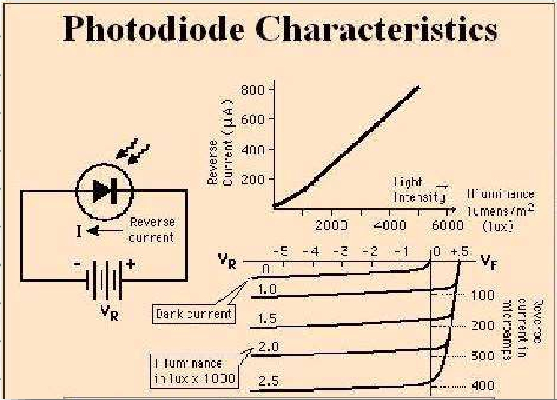



Slide 47
Applications
Photodiodes are used in consumer electronics devices such as CD players, smoke detectors, and the receivers for infrared remote-control devices used to control equipment from televisions to air conditioners.
Photodiodes are used as a light sensors.
Photodiodes are often used for accurate measurement of light intensity in science and industry.
They are also widely used in various medical applications, such as detectors for computer tomography, instruments to analyze samples, and pulse oximeters.

Slide 48

Basic Biasing Arrangement and construction of photodiode and symbols

Slide 49
UNIT-II
Rectifiers and Filters : The P-N junction as a Rectifier, Half wave Rectifier, Full wave Rectifier, Bridge Rectifier, Inductor Filters, Capacitor Filters, L- Section Filters,π- Section Filters, Zener diode as a voltage regulator.

Slide 50


Slide 51


Slide 52


Slide 53


Slide 54


Slide 55


Slide 56


Slide 57


Slide 58


Slide 59


Slide 60


Slide 61


Slide 62


Slide 63


Slide 64


Slide 65


Slide 66

Half-Wave Rectifier(HWR).
It converts an ac voltage into a pulsating dc voltage using only one half of the applied ac voltage.
The rectifying diode conducts only during one half of the ac cycle.
Let vi be the voltage applied to the primary of the transformer and given by the equation vi = Vm sin(ωt) ; Vm >> Vγ where Vγ is the cut-in voltage of the diode.

Slide 67
During positive half of the input signal, the anode of the diode D1 becomes positive and at the same time, the anode of diode D2 becomes negative. Hence, D1 conducts and D2 does not conduct. The load current flows through D1 and the voltage drop across RL will be equal to the input voltage.
During the negative half-cycle of the input, the anode of D1 becomes negative and the anode of D2 becomes positive. Hence, D1 does not conduct and D2 conducts. The load current flows through D2 and the voltage drop across RL will be equal to the input voltage.

Slide 68

During the positive half cycle, the diode is under forwarding bias condition, and it conducts current to RL (Load resistance). A voltage is developed across the load, which is the same as the input AC signal of the positive half cycle.
Alternatively, during the negative half cycle, the diode is under reverse bias condition and there is no current flow through the diode. Only the AC input voltage appears across the load and it is the net result which is possible during the positive half cycle. The output voltage pulsates the DC voltage.

Slide 69
During the positive half cycle of the input signal, the anode of the diode becomes more positive with respect to the cathode and hence, the diode D conducts. For an ideal diode, the forward voltage drop is zero. So, the whole input voltage will appear across the load resistance, RL.
During negative half cycle of the input signal, the anode of the diode becomes negative with respect to the cathode and hence, diode D does not conduct. For an ideal diode, the impedance offered by the diode is infinity. So the whole input voltage appears across diode D. Hence, the voltage drop across RL is zero.

Slide 70
Ripple Factor ( γ )
Efficiency
Peak Inverse Voltage (PIV)
Transformer Utilization Factor (TUF
Form Factor
Peak Factor
Voltage Regulation

Slide 71


Slide 72


Slide 73



Slide 74

Problem

Slide 75

Problem

Slide 76

Problem

Slide 77


Problem

Slide 78

Full-Wave Rectifier(FWR).
It converts an ac voltage into a pulsating dc voltage using both half cycles of the applied ac voltage.
It uses two diodes of which one conducts during one half-cycle while the other diode conducts during the other half-cycle of the applied ac voltage.
There are two types of full-wave rectifier, viz., (i), full-wave rectifier with centre-tapped transformer, and (ii) full-wave rectifier without transformer (bridge rectifier).

Slide 79




Slide 80



Slide 81


Problem

Slide 82


Problem

Slide 83


Problem

Slide 84


Problem

Slide 85
BY
G.BABU
Assoc.Prof.
ECE-VCE
UNIT-3
Bipolar Junction Transistors(BJT’s)

Slide 86
UNIT-III
Bipolar Junction Transistor: The Junction Transistor, Transistor Construction, BJT Operation, Transistor Current Components, BJT Symbol, Common Base, Common Emitter and Common Collector Configurations, Transistor as an Amplifier, UJT construction and V-I characteristics.

Slide 87
The Invention
The First Transistor: On Dec 23, 1947, three scientists led by Dr. William Shockley at the Bell Telephone Laboratories demonstrated the amplifying action of the first transistor. (Courtesy Bell Telephone Laboratories.)
Co-inventors:
Dr. William Shockley (seated);
Dr. John Bardeen (left);
Dr. Walter H. Brattain.
Honored with Nobel Prize in Physics in 1956
Important Features (compared to Vacuum tubes):
- three terminal solid-state device - requires less power - smaller and lightweight - lower operating voltage
- has rugged construction - more efficient
- no heater requirement

Slide 88

The Structure
The Bipolar Junction Transistor (BJT)
Bipolar: both electrons and holes are involved in current flow.
Junction: has two p-n junctions.
Transistor: Transfer + Resistor.
It can be either n-p-n type or p-n-p type.
Has three regions with three terminals labeled as
i. Emitter (E)
ii. Base (B) and
iii. Collector (C)

Slide 89

The Structure: npn & pnp
Base is made much narrow.
Emitter is heavily doped (p⁺, n⁺).
Base is lightly doped (p⁻, n⁻).
Collector is lightly doped (p, n).

Slide 90

Circuit Symbol
Layout and Circuit Symbol: p-n-p Transistor
The arrow indicates the direction of current flow.
The current flows from emitter to collector in an p-n-p transistor.
The arrow points towards the n-type.
So the base is n-type and transistor is p-n-p type.

Slide 91


Slide 92


Transistor Symbol

Slide 93


TRANSISTOR:
A transistor is a semiconductor device used to amplify or switch electronic signals and electrical power. Transistors are one of the basic building blocks of modern electronics. It is composed of semiconductor material usually with at least three terminals for connection to an external circuit.

Slide 94


Slide 95




Slide 96



Slide 97


Slide 98



Slide 99






Slide 100


Slide 101





Slide 102


Slide 103



Slide 104


Slide 105



Slide 106


Slide 107



Slide 108


Slide 109


Slide 110



Slide 111


Slide 112


Slide 113


Slide 114


Slide 115


Slide 116



Slide 118


Slide 119


Slide 120


Slide 121



Slide 122




Slide 123



Slide 124



Slide 125


Slide 126


Slide 127




Slide 128


Slide 129


Slide 130



Slide 131


Slide 132


Slide 133



Slide 134




Slide 135






Slide 136


BREAD BOARD
DIGITAL MULTIMETER
9V BATTERY

Slide 137



Slide 138



FUNCTION GENERATOR REGULATED POWER SUPPLY(RPS) CATHODE RAY OSCILLATOR(CRO)

Slide 139


Slide 140





Slide 141


Slide 142



Slide 143



Slide 144

Vp – Peak voltage (point)
Vv - Valley voltage (point)
UJT APPLICATIONS
Used in a wide variety of applications like oscillators, pulse generators, saw-tooth generators, triggering circuits, phase control, timing circuits, and voltage- or current-regulated supplies.

