Slide 1
FPGA
UNIT – 1
Programmable Logic Devices, CMOS Testing
G.BABU ( ASSOCIATE PROFESSOR)
E.C.E Dept.

Slide 2
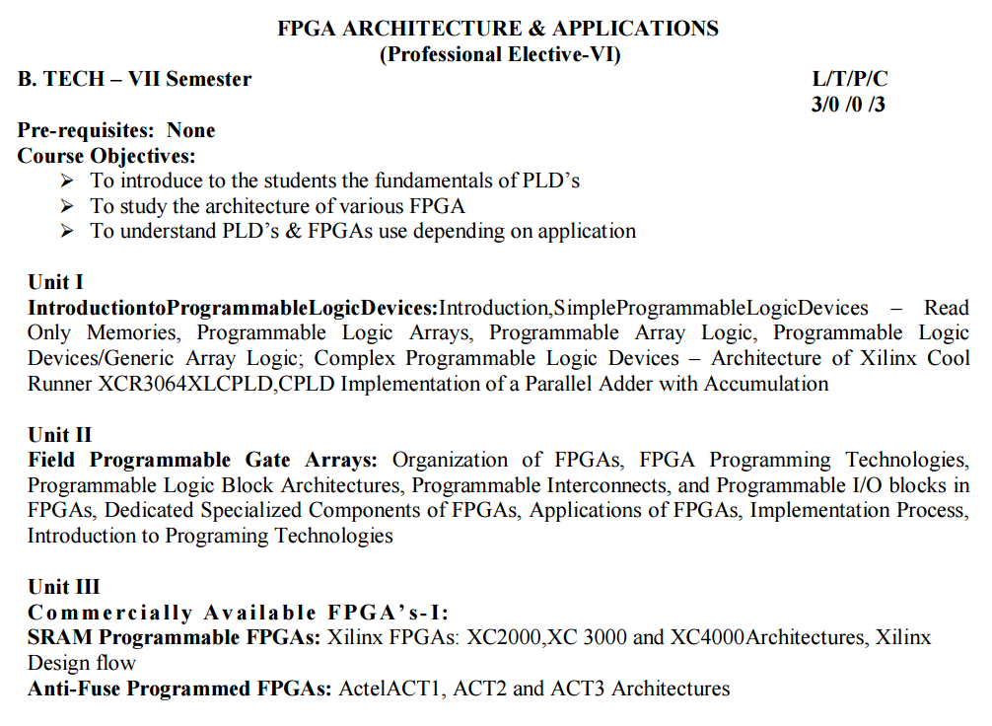

Slide 3
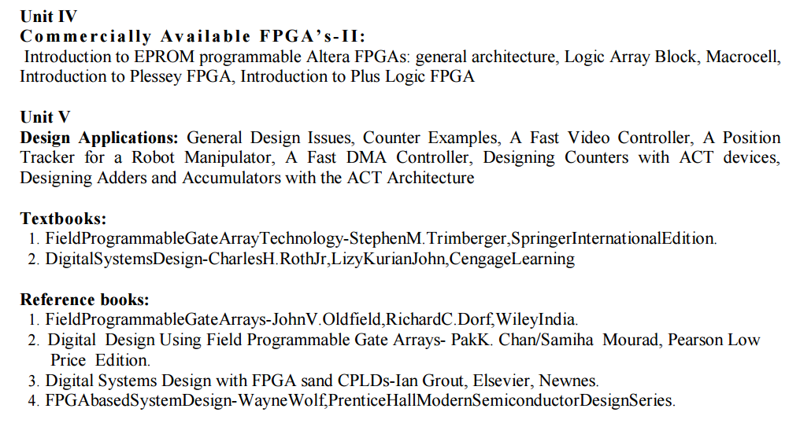

Slide 4
UNIT –V
Programmable Logic Devices: PLAs, FPGAs, CPLDs, Standard Cells, Programmable Array Logic, Design Approach, Parameters influencing low power design.
CMOS Testing: CMOS Testing, Need for testing, Test Principles, Design Strategies for test, Chip level Test Techniques.

Slide 5
Problems by Using Basic Gates
Many components on PCB:
-As no. of components rise, nodes interconnection complexity grow exponentially
-Growth in interconnection will cause increase in interference, PCB size, PCB design cost, and manufacturing time.
Hardware realization of logic networks is generally very time-consuming and expensive.
Once logic functions are realized in hardware, it is difficult to change them.

Slide 6
Programmable Logic Device (PLD):
Also known as “Field Programmable Logic Device (FPLD)”
A programmable logic device (PLD) is an electronic component used to build reconfigurable digital circuits.
Unlike integrated circuits (IC) which consist of logic gates and have a fixed function, a PLD has an undefined function at the time of manufacture.
Can be configured by the user to implement different digital hardware.
Is capable of being erased and reprogrammed with a new design.

Slide 7
Advantages of PLDs
Cost effective in lower volumes
Short design time
Well suited for academics and prototyping
Programmability
Re-programmability
PLDs can be reprogrammed without being removed from the circuit board.
Low cost of design
Immediate hardware implementation
PLD
ASIC
Cost
(Application Specific Integrated Circuit)
Volume

Slide 8
Types of PLDs
SPLDs (Simple Programmable Logic Devices)
ROM (Read-Only Memory)
PLA (Programmable Logic Array)
PAL (Programmable Array Logic)
GAL (Generic Array Logic)
HCPLD (High Capacity Programmable Logic Device)
CPLD (Complex Programmable Logic Device)
FPGA (Field-Programmable Gate Array)

Slide 9
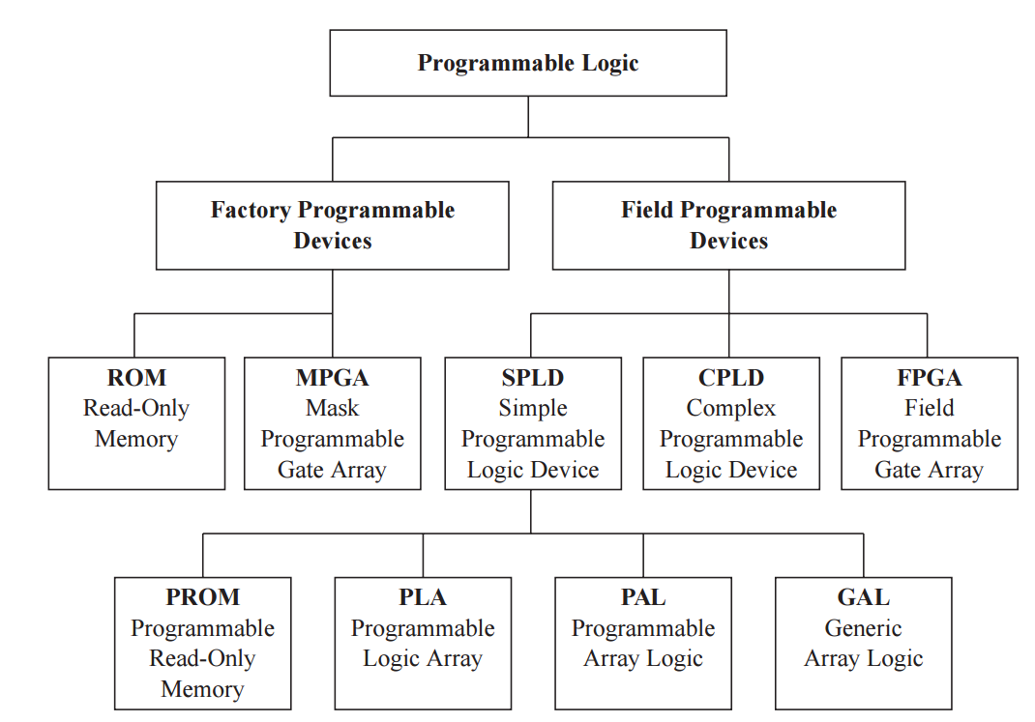
Major Programmable Logic Devices
The term field indicates that this type of device is programmed in the user’s “field” rather than in a semiconductor fab.

Slide 10
Types of PLD’s
PLD
SPLD
PAL
GAL
HCPLD
CPLD
ROM
PLA
FPGA

Slide 11
SPLDs
The differences between the first three categories are these:
ROM has fixed AND gate array but programmable OR gate array.
PLA has programmable AND gate array and programmable OR gate array.
PAL has programmable AND gate array but fixed OR gate array.

Slide 12
SPLDs
In ROM, the input connection matrix is hardwired and the user can only modify the output connection matrix.
In PAL and GAL the output connection matrix is also hardwired and the user can modify the input connection matrix.
In PLA the user can modify both the input connection matrix and the output connection matrix.

Slide 13
HCPLDs
CPLD (Complex Programmable Logic Device)
Lies between PALs and FPGAs in degree of complexity.
Inexpensive
FPGA (Field-Programmable Gate Array)
Truly parallel design and operation
Fast turnaround design
Array of logic cells surrounded by programmable I/O blocks

Slide 14
Buffer/inverter
(a) Symbol. (b) Logic equivalent.

Slide 17
(Programmable Read Only Memory)

Slide 19
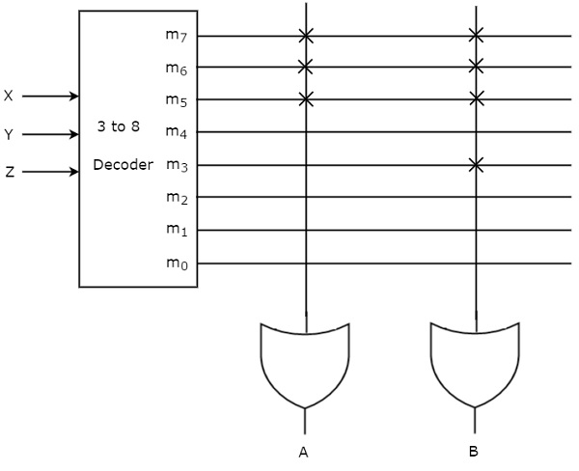

Slide 20
(Programmable Array Logic)

Slide 22
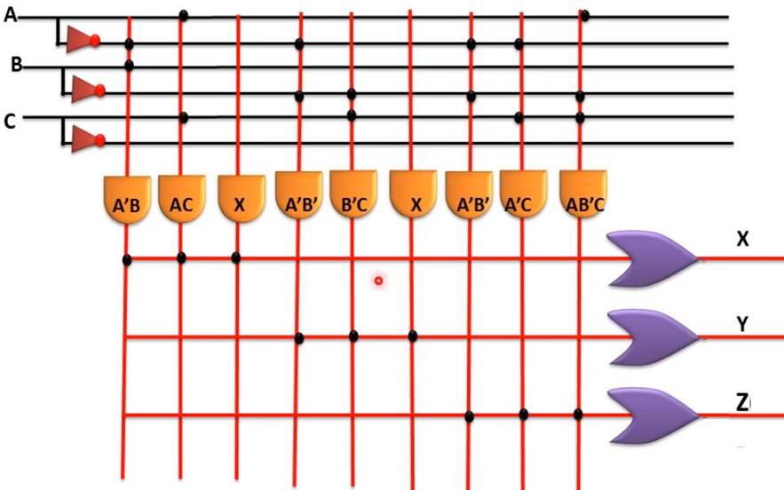

Slide 23
(Programmable Logic Array)
PLA is similar to a ROM in concept; however it does not provide full decoding of variables and does not generate all minterms as in the ROM.

Slide 25
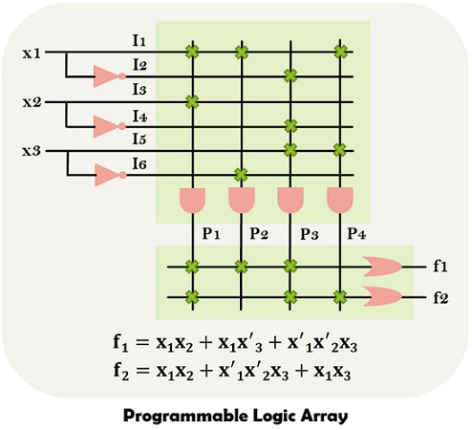

Slide 29
FPGA architecture consists of three types of modules.
They are 1. I/O blocks or Pads, 2. Switch Matrix/ Interconnection Wires and 3. Configurable logic blocks (CLB).
The basic FPGA architecture has two dimensional arrays of logic blocks with a means for a user to arrange the interconnection between the logic blocks.
The functions of an FPGA architecture module are:
CLB (Configurable Logic Block) includes digital logic, inputs, outputs. It implements the user logic.
Interconnects provide direction between the logic blocks to implement the user logic.
Depending on the logic, switch matrix provides switching between interconnects.
I/O Pads used for the outside world to communicate with different applications.

Slide 30
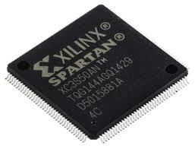
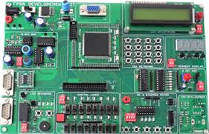
Xilinx Spartan 6 FPGA Development Board

Slide 31
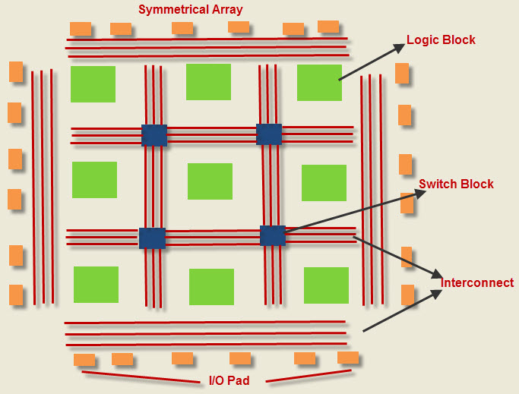
FPGA Architecture

Slide 32
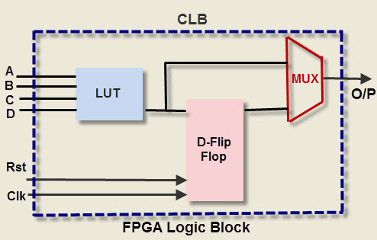
FPGA Logic Block

Slide 33
FPGA Logic Block
It can used to implement different combinations of combinational and sequential logic functions.
Can be implemented by any of the following:
1. Transistor pairs
2. Combinational gates like basic NAND gates or XOR gates
3. n-input Lookup tables
4. Multiplexers
5. Wide fan-in And-OR structure.
look up table is used to implement any number of different
functionality.
The input lines go into the input and enable the lookup table. The output of the lookup table gives the result of the logic function that it implements.
Lookup table is implemented using SRAM cells and multiplexers.

Slide 34
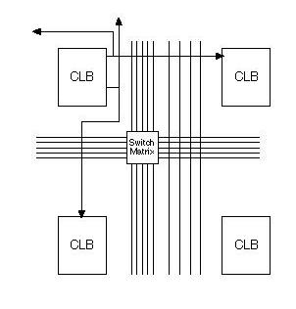
FPGA Programmable Interconnect

Slide 35
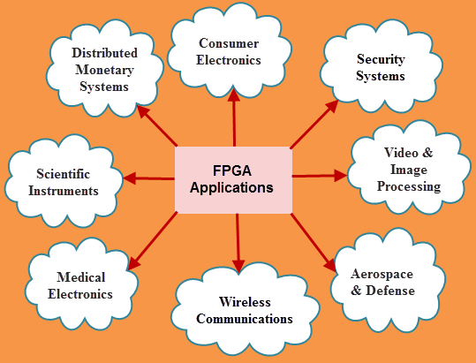
Applications of FPGA

Slide 36
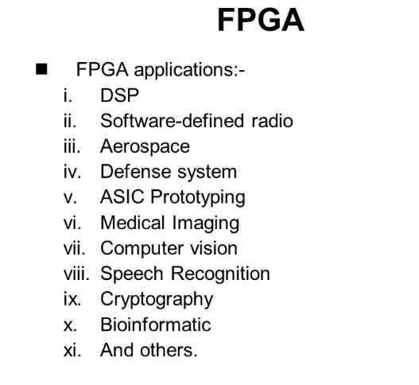

Slide 37
CPLD (complex programmable logic device)
A complex programmable logic device (CPLD) is a programmable logic device with complexity between that of PALs and FPGAs, and architectural features of both.
A Complex Programmable Logic Device (CPLD) is a combination of a fully programmable AND/OR array and a bank of macrocells.
The main building block of the CPLD is a macrocell, which contains logic implementing disjunctive normal form (sum of products (SOP)) expressions and more specialized logic operations.
The main distinction between FPGA and CPLD device architectures is that FPGAs are internally based on look-up tables (LUTs) while CPLDs form the logic functions with sea-of-gates (for example, sum of products).

Slide 39
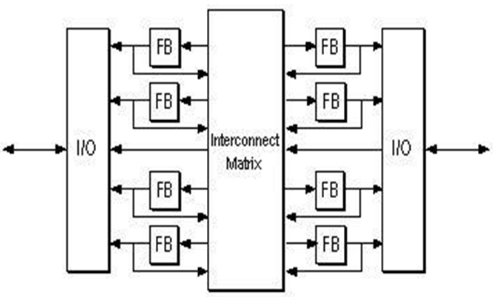
CPLD Architecture
consist of 1.Function blocks, 2.Input/output block, and 3.Interconnect matix
programmed using programmable Elements that, depending on the technology of the manufacturer, can be EPROM cells, EEPROM cells, or Flash EPROM cells.

Slide 40
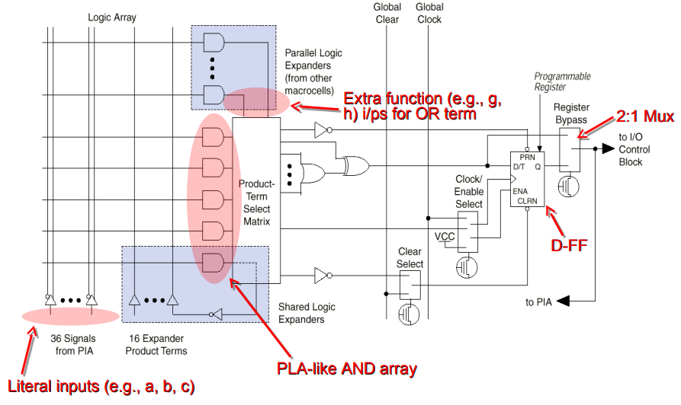
CPLD Function Blocks

Slide 41
Function or Logic Blocks
The AND plane still exists as shown by the crossing wires. The AND plane can accept inputs from the I/O blocks, other function blocks, or feedback from the same function block.
The terms and then ORed together using a fixed number of OR gates, and terms are selected via a large multiplexer.
The outputs of the mux can then be sent straight out of the block, or through a clocked flip-flop.
This particular block includes additional logic such as a selectable exclusive OR and a master reset signal, in addition to being able to program the polarity at different stages.
Usually, the function blocks are designed to be similar to existing PAL architectures,

Slide 42
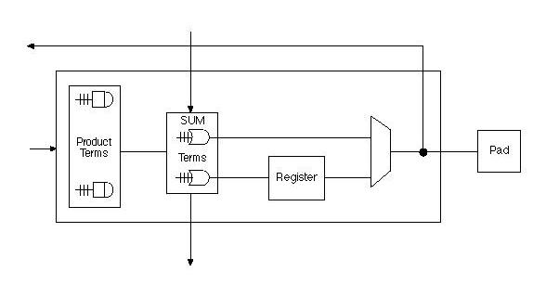
CPLD Input/Output Block
The I/O block is used to drive signals to the pins of the CPLD device at the appropriate voltage levels with the appropriate current.
Usually, a flip-flop is included. This is done on outputs so that clocked signals can be output directly to the pins without encountering significant delay.

Slide 43
Interconnect (wires)
The CPLD interconnect is a very large programmable switch matrix that allows signals from all parts of the device go to all other parts of the device.

Slide 45
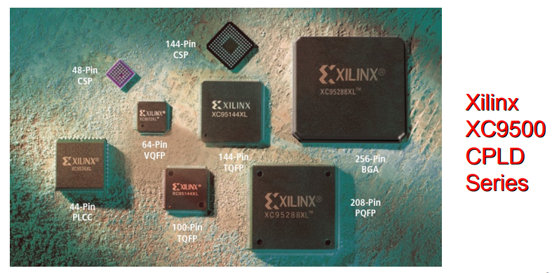
CPLD Families

Slide 46
CMOS Testing: CMOS Testing, Need for testing, Test Principles, Design Strategies for test, Chip level Test Techniques.

