Slide 1
Data Mining: Concepts and Techniques — Chapter 1 — — Introduction —

Slide 2
Outline
1.1 Motivation: Why data mining?
1.2 What is data mining?
1.3 Data Mining: On what kind of data?
1.4 Data mining functionality: What kinds of Patterns Can Be Mined?
1.5 Are all the patterns interesting?
1.6 Classification of data mining systems
1.7 Data Mining Task Primitives
1.8 Integration of data mining system with a DB and DW System
1.9 Major issues in data mining

Slide 3
1.1 Why Data Mining?
The Explosive Growth of Data: from terabytes(1000⁴) to yottabytes(1000⁸)
Data collection and data availability
Automated data collection tools, database systems, web
Major sources of abundant data
Business: Web, e-commerce, transactions, stocks, …
Science: bioinformatics, scientific simulation, medical research …
Society and everyone: news, digital cameras, …
Data rich but information poor!
What does those data mean?
How to analyze data?
Data mining — Automated analysis of massive data sets

Slide 4
Evolution of Database Technology

Slide 5
1.2 What Is Data Mining?
Data mining (knowledge discovery from data)
Extraction of interesting (non-trivial, implicit, previously unknown and potentially useful) patterns or knowledge from huge amount of data
Data mining: a misnomer?
Alternative names
Knowledge discovery (mining) in databases (KDD), knowledge
extraction, data/pattern analysis, data archeology, data dredging, information harvesting, business intelligence, etc.

Slide 6
Potential Applications
Data analysis and decision support
Market analysis and management
Target marketing, customer relationship management (CRM),
market basket analysis, cross selling, market segmentation
Risk analysis and management
Forecasting, customer retention, improved underwriting, quality
control, competitive analysis
Fraud detection and detection of unusual patterns (outliers)
Other Applications
Text mining (news group, email, documents) and Web mining
Stream data mining
Bioinformatics and bio-data analysis

Slide 7
Ex.: Market Analysis and Management
Where does the data come from?—Credit card transactions, loyalty cards,
discount coupons, customer complaint calls, surveys …
Target marketing
Find clusters of “model” customers who share the same characteristics: interest,
income level, spending habits, etc.,
E.g. Most customers with income level 60k – 80k with food expenses $600 - $800 a month live in that area
Determine customer purchasing patterns over time
E.g. Customers who are between 20 and 29 years old, with income of 20k – 29k usually buy this type of CD player
Cross-market analysis—Find associations/co-relations between product sales, & predict based on such association
E.g. Customers who buy computer A usually buy software B

Slide 8
Ex.: Market Analysis and Management (2)
Customer requirement analysis
Identify the best products for different customers
Predict what factors will attract new customers
Provision of summary information
Multidimensional summary reports
E.g. Summarize all transactions of the first quarter from three different branches
Summarize all transactions of last year from a particular branch
Summarize all transactions of a particular product
Statistical summary information
E.g. What is the average age for customers who buy product A?
Fraud detection
Find outliers of unusual transactions
Financial planning
Summarize and compare the resources and spending

Slide 9
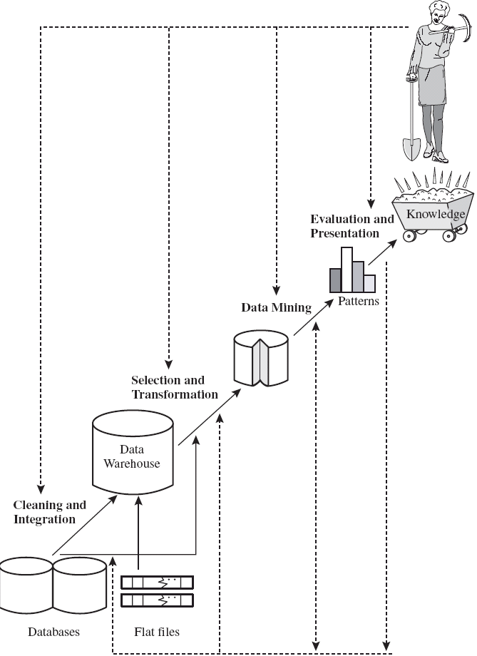
Knowledge Discovery (KDD) Process

Slide 10
KDD Process: Several Key Steps
Learning the application domain
relevant prior knowledge and goals of application
Identifying a target data set: data selection
Data processing
Data cleaning (remove noise and inconsistent data)
Data integration (multiple data sources maybe combined)
Data selection (data relevant to the analysis task are retrieved from database)
Data transformation (data transformed or consolidated into forms appropriate for mining)
(Done with data preprocessing)
Data mining (an essential process where intelligent methods are applied to extract
data patterns)
Pattern evaluation (indentify the truly interesting patterns)
Knowledge presentation (mined knowledge is presented to the user with
visualization or representation techniques)
Use of discovered knowledge

Slide 11
Data Mining and Business Intelligence
Increasing potential
to support
business decisions
End User
Decision Making
Data Presentation
Business
Analyst
Visualization Techniques
Data Mining
Data
Analyst
Information Discovery
Data Exploration
Statistical Summary, Querying, and Reporting
Data Preprocessing/Integration, Data Warehouses
Data Sources
DBA
Paper, Files, Web documents, Scientific experiments, Database Systems

Slide 12
A typical DM System Architecture
Database, data warehouse, WWW or other information
repository (store data)
Database or data warehouse server (fetch and
combine data)
Knowledge base (turn data into meaningful groups
according to domain knowledge)
Data mining engine (perform mining tasks)
Pattern evaluation module (find interesting patterns)
User interface (interact with the user)

Slide 13
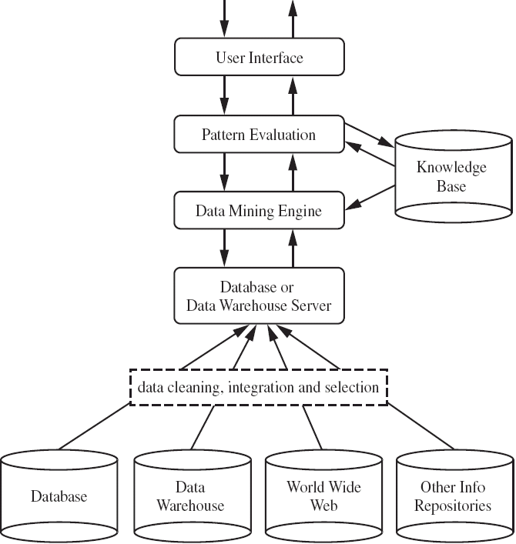
A typical DM System Architecture (2)

Slide 14
Confluence of Multiple Disciplines
Database
Technology
Statistics
Information
Science
Data Mining
Machine
Learning
Visualization
Other
Disciplines
Not all “Data Mining System” performs true data mining
machine learning system, statistical analysis (small amount of data)
Database system (information retrieval, deductive querying…)

Slide 15
1.3 On What Kinds of Data?
Database-oriented data sets and applications
Relational database, data warehouse, transactional database
Advanced data sets and advanced applications
Object-Relational Databases
Temporal Databases, Sequence Databases, Time-Series databases
Spatial Databases and Spatiotemporal Databases
Text databases and Multimedia databases
Heterogeneous Databases and Legacy Databases
Data Streams
The World-Wide Web

Slide 16
Relational Databases
DBMS – database management system, contains a collection of
interrelated databases
e.g. Faculty database, student database, publications database
Each database contains a collection of tables and functions to
manage and access the data.
e.g. student_bio, student_graduation, student_parking
Each table contains columns and rows, with columns as attributes of data and rows as records.
Tables can be used to represent the relationships between or among multiple tables.

Slide 17
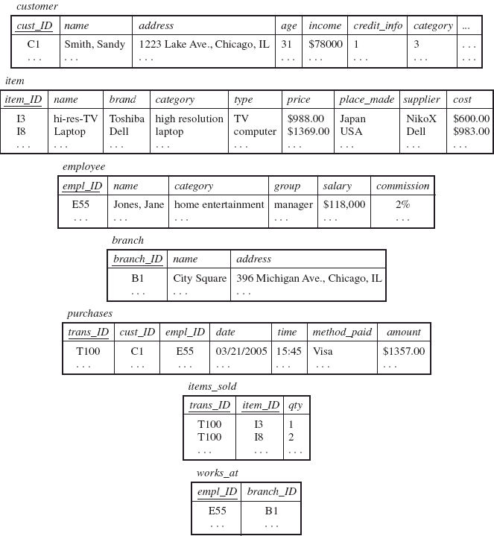
Relational Databases (2) – AllElectronics store

Slide 18
Relational Databases (3)
With a relational query language, e.g. SQL, we will be able to find
answers to questions such as:
How many items were sold last year?
Who has earned commissions higher than 10%?
What is the total sales of last month for Dell laptops?
When data mining is applied to relational databases, we can search for trends or data patterns.
Relational databases are one of the most commonly available and
rich information repositories, and thus are a major data form in our study.

Slide 19
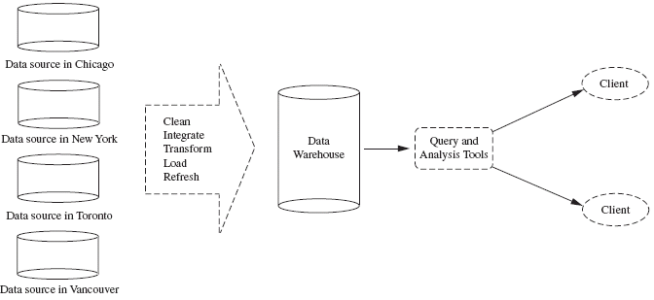
Data Warehouses
A repository of information collected from multiple sources, stored
under a unified schema, and that usually resides at a single site.
Constructed via a process of data cleaning, data integration, data
transformation, data loading and periodic data refreshing.

Slide 20
Data Warehouses (2)
Data are organized around major subjects, e.g. customer, item, supplier and activity.
Provide information from a historical perspective (e.g. from the past 5 – 10 years)
Typically summarized to a higher level (e.g. a summary of the
transactions per item type for each store)
User can perform drill-down or roll-up operation to view the data at different degrees of summarization

Slide 21
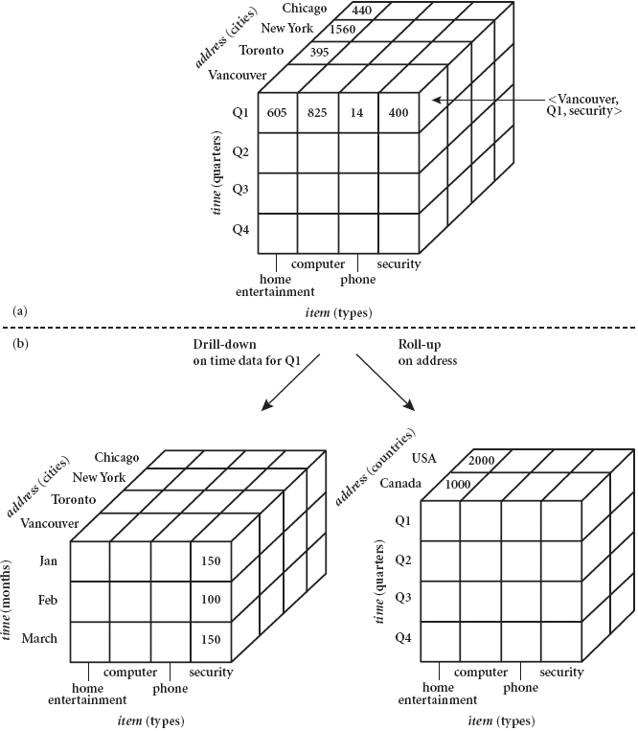
Data Warehouses (3)

Slide 22
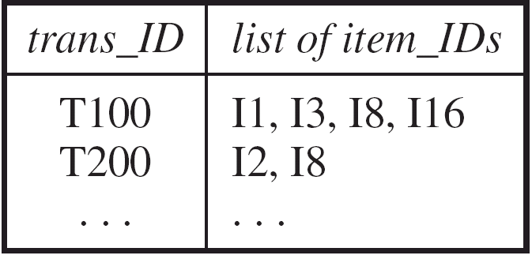
Transactional Databases
Consists of a file where each record represents a transaction
A transaction typically includes a unique transaction ID and a list of the items making up the transaction.
Either stored in a flat file or unfolded into relational tables
Easy to identify items that are frequently sold together

Slide 23
1.4 Data Mining Functionalities - What kinds of patterns can be mined?
Concept/Class Description: Characterization and Discrimination
Data can be associated with classes or concepts.
E.g. classes of items – computers, printers, …
concepts of customers – bigSpenders, budgetSpenders, …
How to describe these items or concepts?
Descriptions can be derived via
Data characterization – summarizing the general characteristics of a
target class of data.
E.g. summarizing the characteristics of customers who spend more than $1,000 a year
at AllElectronics. Result can be a general profile of the customers, such as 40 – 50 years old, employed, have excellent credit ratings.

Slide 24
1.4 Data Mining Functionalities - What kinds of patterns can be mined?
Data discrimination – comparing the target class with one or a set of
comparative classes
E.g. Compare the general features of software products whole sales increase by 10% in the last year with those whose sales decrease by 30% during the same period
Or both of the above
Mining Frequent Patterns, Associations and
Correlations
Frequent itemset: a set of items that frequently appear
together in a transactional data set (e.g. milk and bread)
Frequent subsequence: a pattern that customers tend to purchase product A, followed by a purchase of product B

Slide 25
1.4 Data Mining Functionalities - What kinds of patterns can be mined?
Association Analysis: find frequent patterns
E.g. a sample analysis result – an association rule:
buys(X, “computer”) => buys(X, “software”) [support = 1%, confidence = 50%]
(if a customer buys a computer, there is a 50% chance that she will buy software. 1% of all of the transactions under analysis showed that computer and software
are purchased together. )
Associations rules are discarded as uninteresting if they do not satisfy both a minimum support threshold and a minimum confidence threshold.
Correlation Analysis: additional analysis to find statistical correlations between associated pairs

Slide 26
1.4 Data Mining Functionalities - What kinds of patterns can be mined?
Classification and Prediction
Classification
The process of finding a model that describes and distinguishes the data classes or concepts, for the purpose of being able to use the model to predict the class of
objects whose class label is unknown.
The derived model is based on the analysis of a set of training data (data objects whose class label is known).
The model can be represented in classification (IF-THEN) rules, decision trees,
neural networks, etc.
Prediction
Predict missing or unavailable numerical data values

Slide 27
1.4 Data Mining Functionalities - What kinds of patterns can be mined?

Slide 28
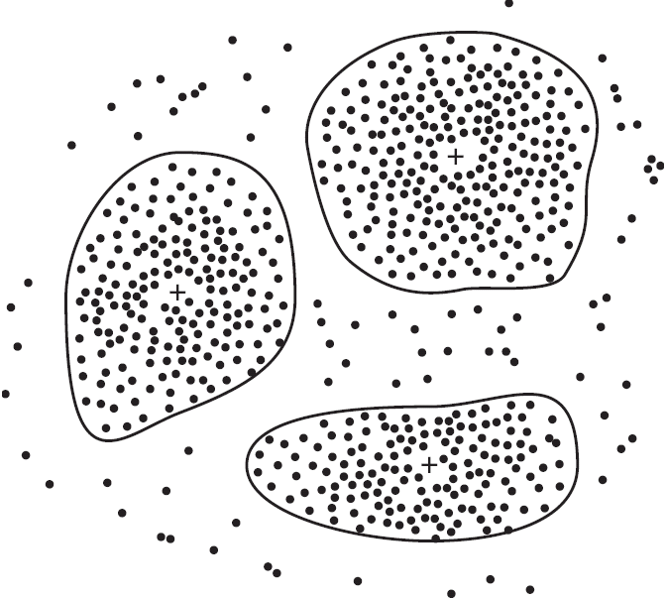
Data Mining Functionalities (2)
Cluster Analysis
Class label is unknown: group data to form new classes
Clusters of objects are formed based on the principle of maximizing intra-class similarity & minimizing interclass similarity
E.g. Identify homogeneous subpopulations of customers. These clusters may
represent individual target groups for marketing.

Slide 29
Data Mining Functionalities (2)
Outlier Analysis
Data that do no comply with the general behavior or model.
Outliers are usually discarded as noise or exceptions.
Useful for fraud detection.
E.g. Detect purchases of extremely large amounts
Evolution Analysis
Describes and models regularities or trends for objects whose
behavior changes over time.
E.g. Identify stock evolution regularities for overall stocks and for the stocks of
particular companies.

Slide 30
1.5 Are All of the Patterns Interesting?
Data mining may generate thousands of patterns: Not all of them
are interesting
A pattern is interesting if it is
easily understood by humans
valid on new or test data with some degree of certainty,
potentially useful
novel
validates some hypothesis that a user seeks to confirm
An interesting measure represents knowledge !

Slide 31
1.5 Are All of the Patterns Interesting?
Objective measures
Based on statistics and structures of patterns, e.g., support, confidence, etc. (Rules that do not satisfy a threshold are considered uninteresting.)
Subjective measures
Reflect the needs and interests of a particular user.
E.g. A marketing manager is only interested in characteristics of customers who shop
frequently.
Based on user’s belief in the data.
e.g., Patterns are interesting if they are unexpected, or can be used for strategic planning, etc
Objective and subjective measures need to be combined.

Slide 32
1.5 Are All of the Patterns Interesting?
Find all the interesting patterns: Completeness
Unrealistic and inefficient
User-provided constraints and interestingness measures should be used
Search for only interesting patterns: An optimization problem
Highly desirable
No need to search through the generated patterns to identify truly
interesting ones.
Measures can be used to rank the discovered patterns according their
interestingness.

Slide 33
1.6 Classification of data mining systems
Database
Technology
Statistics
Information
Science
Data Mining
Machine
Learning
Visualization
Other
Disciplines

Slide 34
1.6 Classification of data mining systems
Database
Relational, data warehouse, transactional, stream, object-oriented/relational, active, spatial, time-series, text, multi-media, heterogeneous, legacy, WWW
Knowledge
Characterization, discrimination, association, classification, clustering, trend/deviation, outlier analysis, etc.
Multiple/integrated functions and mining at multiple levels
Techniques utilized
Database-oriented, data warehouse (OLAP), machine learning, statistics,
visualization, etc.
Applications adapted
Retail, telecommunication, banking, fraud analysis, bio-data mining, stock
market analysis, text mining, Web mining, etc.

Slide 35
1.7 Data Mining Task Primitives
How to construct a data mining query?
The primitives allow the user to interactively communicate with
the data mining system during discovery to direct the mining
process, or examine the findings

Slide 36
1.7 Data Mining Task Primitives
The primitives specify:
(1) The set of task-relevant data – which portion of the database to be used
Database or data warehouse name
Database tables or data warehouse cubes
Condition for data selection
Relevant attributes or dimensions
Data grouping criteria

Slide 37
1.7 Data Mining Task Primitives
The primitives specify:
(2) The kind of knowledge to be mined – what DB functions to be performed
Characterization
Discrimination
Association
Classification/prediction
Clustering
Outlier analysis
Other data mining tasks

Slide 38
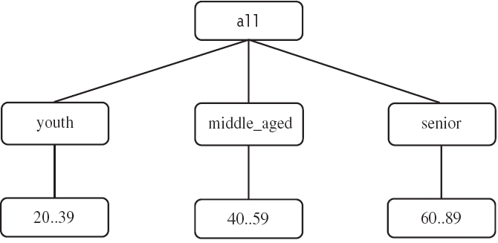
1.7 Data Mining Task Primitives
(3) The background knowledge to be used – what domain knowledge,
concept hierarchies, etc.
(4) Interestingness measures and thresholds – support, confidence, etc.
(5) Visualization methods – what form to display the result, e.g. rules,
tables, charts, graphs, …

Slide 39
1.7 Data Mining Task Primitives
DMQL – Data Mining Query Language
Designed to incorporate these primitives
Allow user to interact with DM systems
Providing a standardized language like SQL

Slide 40
An Example Query in DMQL
(1)
(3)
(2)
(1)
(1)
(1)
(2)
(1)
(5)

Slide 41
Why Data Mining Query Language?
Automated vs. query-driven?
Finding all the patterns autonomously in a database?—unrealistic because the patterns could be too many but uninteresting
Data mining should be an interactive process
User directs what to be mined
Users must be provided with a set of primitives to be used to
communicate with the data mining system
Incorporating these primitives in a data mining query language
More flexible user interaction
Foundation for design of graphical user interface
Standardization of data mining industry and practice

Slide 42
1.8 Integration of Data Mining and Data Warehousing
No coupling
Flat file processing, no utilization of any functions of a DB/DW
system
Not recommended
Loose coupling
Fetching data from DB/DW
Does not explore data structures and query optimization methods provided by DB/DW system
Difficult to achieve high scalability and good performance with
large data sets

Slide 43
1.8 Integration of Data Mining and Data Warehousing
Semi-tight
Efficient implementations of a few essential data mining primitives in a DB/DW system are provided, e.g., sorting, indexing, aggregation,
histogram analysis, multiway join, precomputation of some stat
functions
Enhanced DM performance
Tight
DM is smoothly integrated into a DB/DW system, mining query is
optimized based on mining query analysis, data structures, indexing, query processing methods of a DB/DW system
A uniform information processing environment, highly desirable

Slide 44
1.9 Major Issues in Data Mining
Mining methodology and User interaction
Mining different kinds of knowledge
DM should cover a wide spectrum of data analysis and knowledge discovery tasks
Enable to use the database in different ways
Require the development of numerous data mining techniques
Interactive mining of knowledge at multiple levels of abstraction
Difficult to know exactly what will be discovered
Allow users to focus the search, refine data mining requests
Incorporation of background knowledge
Guide the discovery process
Allow discovered patterns to be expressed in concise terms and different levels of abstraction
Data mining query languages and ad hoc data mining
High-level query languages need to be developed
Should be integrated with a DB/DW query language

Slide 45
1.9 Major Issues in Data Mining
Presentation and visualization of results
Knowledge should be easily understood and directly usable
High level languages, visual representations or other expressive forms
Require the DM system to adopt the above techniques
Handling noisy or incomplete data
Require data cleaning methods and data analysis methods that can handle noise
Pattern evaluation – the interestingness problem
How to develop techniques to access the interestingness of discovered patterns, especially with subjective measures bases on user beliefs or expectations

Slide 46
1.9 Major Issues in Data Mining
Performance Issues
Efficiency and scalability
Huge amount of data
Running time must be predictable and acceptable
Parallel, distributed and incremental mining algorithms
Divide the data into partitions and processed in parallel
Incorporate database updates without having to mine the entire data again from
scratch
Diversity of Database Types
Other database that contain complex data objects, multimedia data,
spatial data, etc.
Expect to have different DM systems for different kinds of data
Heterogeneous databases and global information systems
Web mining becomes a very challenging and fast-evolving field in data mining

